Slide 1

The importance of model interpretation

Slide 2
The Trade-off of Model Interpretation and Performance
Interpretability vs Performance (Trade-off)
Prediction based
Inference based
Notes:
Briefly describe the three points

Slide 3

Prediction Based
Prediction of Crypto Prices

Slide 4
Inference Based
Reasonable Performance
Interpretable
Inference of Melanoma (Skin Cancer)
Notes:
We want to know why the model predicts a cell is malignant to enable the doctor to make more informed decisions.

Slide 5
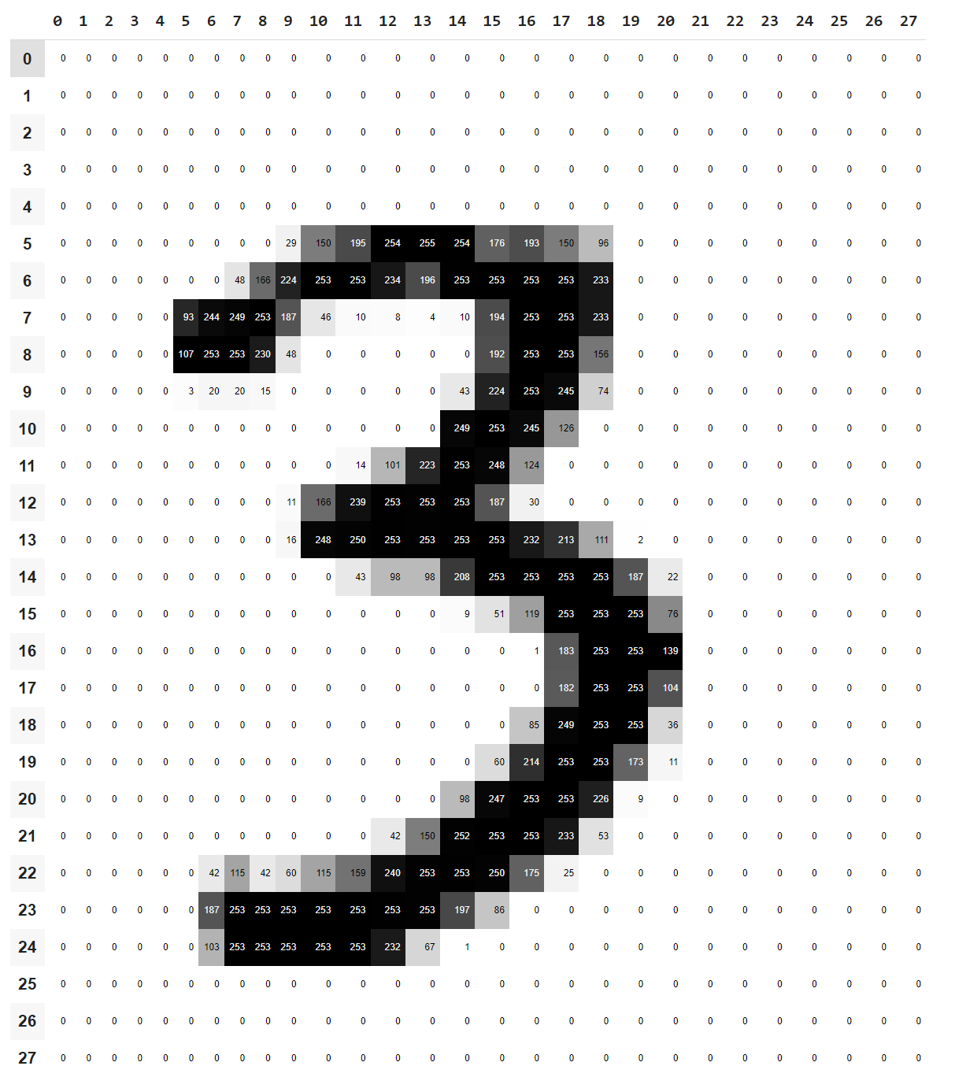
Is Computer Vision a Black Box?
For example, we plot a grayscale image of a number 3 taken from MNIST by pixel level (i.e. 28x28), then it is not immediately obvious how we should recover the "importance" of any single pixel.

Slide 6
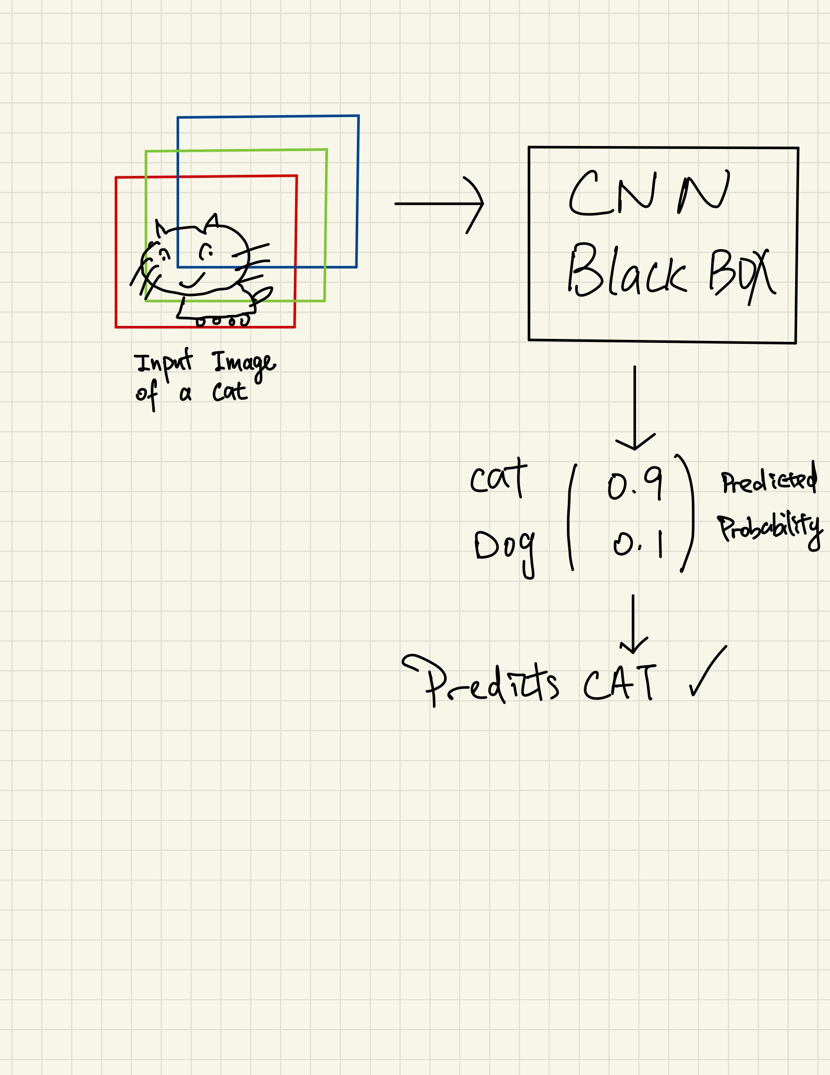
High level overview of a CNN

Slide 7
Methods to Interpret CNN
We will introduce two methods out of many.
Feature Map Output Visualization
Gradient-based Class Activation Maps

Slide 8


Feature Maps
Each CNN layer outputs many feature maps
These feature maps encode information of the image.
More abstract as layers go deeper.
Information Distillation

Slide 9
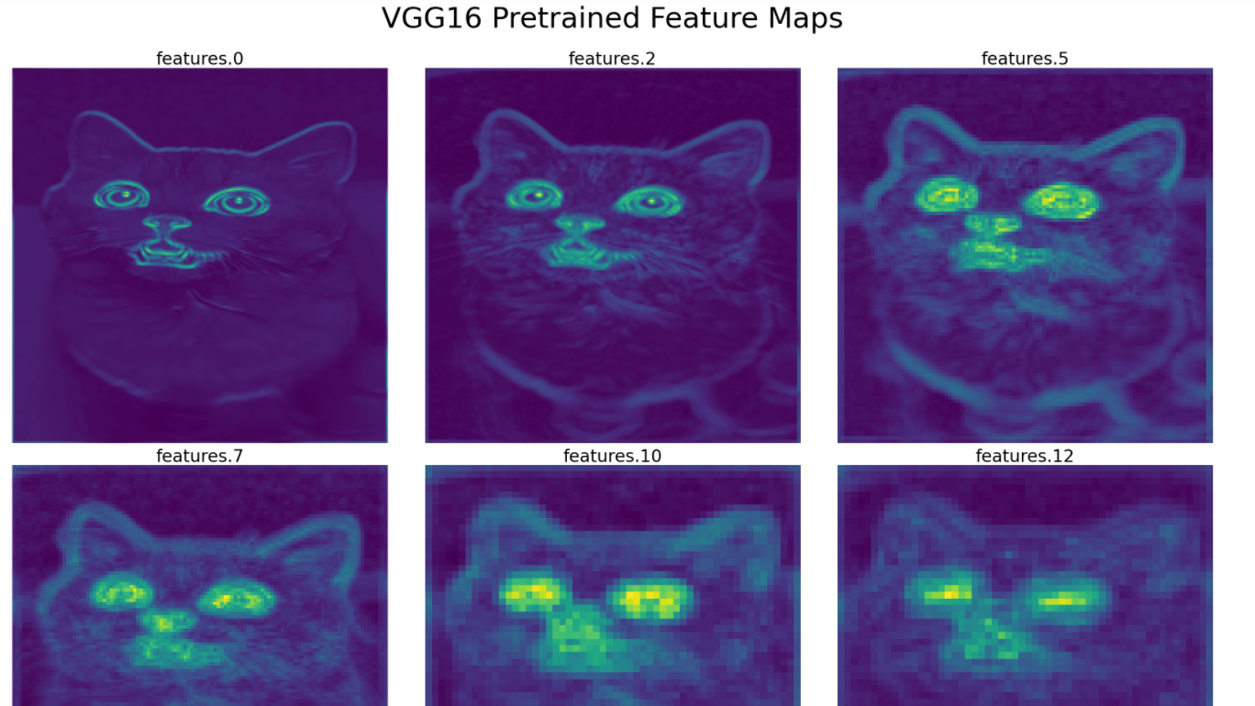
Notes:
Feature Visualization Through Convolutional Layers.
Just give a feel of what the ouputs of conv layers are
Features get very abstract later on and becomes not easily interpretable

Slide 10
Grad-Cam
Using gradients to weight the feature importance
Weigh spatial feature maps by “rate of change”
Can understand it as using gradients to indicate regions of interest.

Slide 11
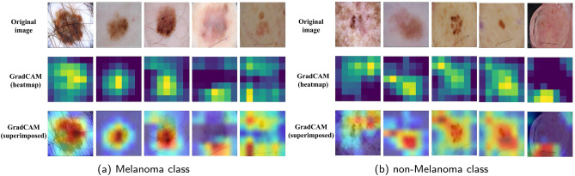
Gradcam in Melanoma
Notes:
Courtesy of
https://www.sciencedirect.com/science/article/abs/pii/S0010482521002122

Slide 12

Thank you

